Slide 1
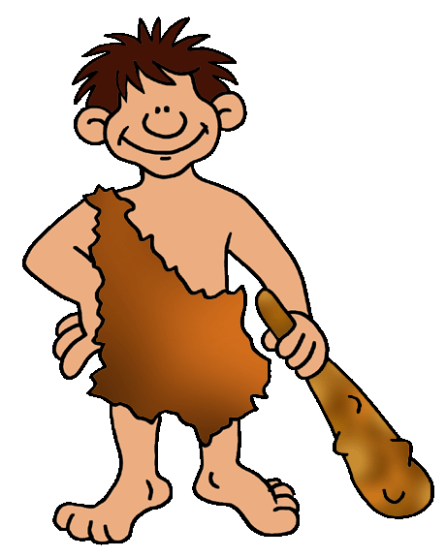
The First Humans
Hominids are the family of mankind and his or her relatives.

Slide 2
65 Million Years Ago
No matter what you may have seen in the movies, early man did not live during the same period in history as dinosaurs!
Dinosaurs died out about 65 million years ago. The first human like hominids did not appear until around 3 million years ago.
Not that early man had it easy, but he did not have to fight dinosaurs!

Slide 3
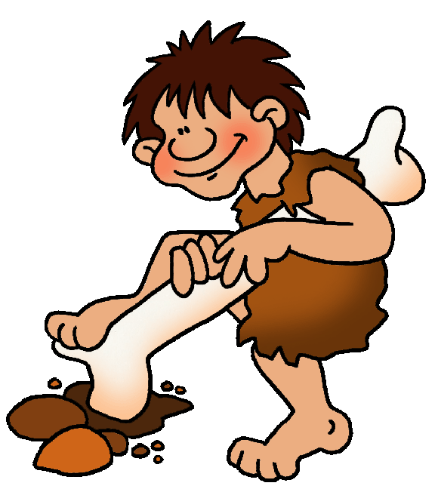
Very Early Humans
It was during this time that the higher primates, including apes and early man, first appeared.
There was a difference between apes and man. Early human-like hominids could stand upright. Apes could not.
Their hands were different, too. Ape hands were made for climbing and clinging. Man’s hands were jointed differently, which allowed them to make and use tools.

Slide 4
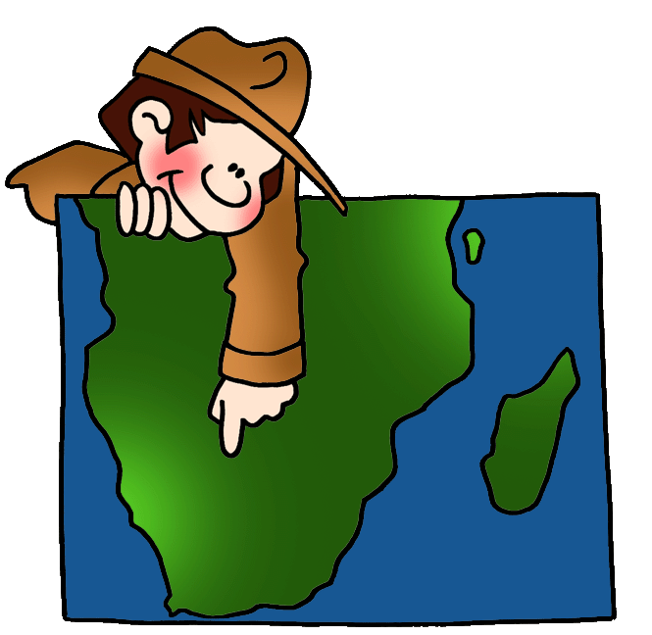
Very Early Humans
How do scientists know about an early man who lived 3 million years ago?
Lucy told them!

Slide 5
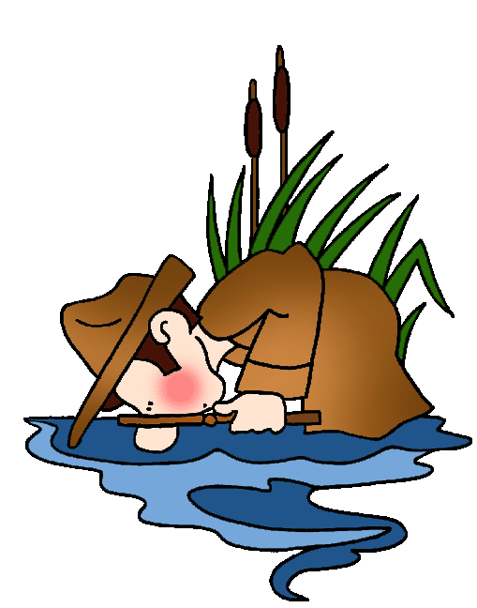
Lucy
In 1974, a skeleton was found in Africa. The bones were those of a female, about 20 years old or so when she died. Scientists named her Lucy. About 3 million years
ago, when Lucy was alive, she was about 4 feet tall and weighed about 50 pounds. Scientists suspect that she fell into a lake or river and drowned.
Scientists are like detectives. They can tell a great deal from a skeleton, whether it's one year old or 3 million years old!

Slide 6
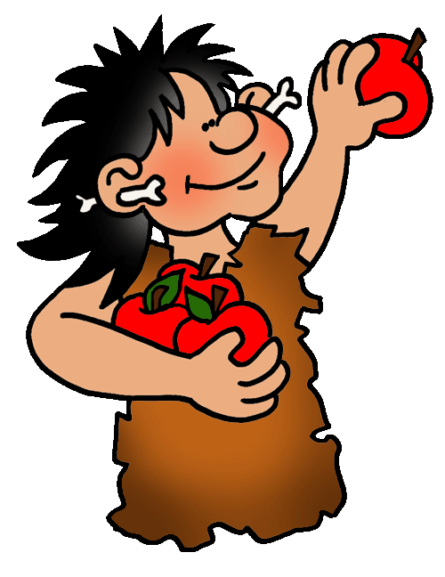
Handy Man
The Stone Age refers to the materials used to make man-made tools. In the Stone Age, man made tools out of stone. “Handy Man” was one of the first hominids to use stone tools.
Hunters & Gatherers: The Old Stone Age people were hunters/gatherers. We know this because scientists have found fossils and artifacts, which reveal traces of their life. These people did not plant crops. They gathered wild fruits, nuts, berries, and vegetables.

Slide 7
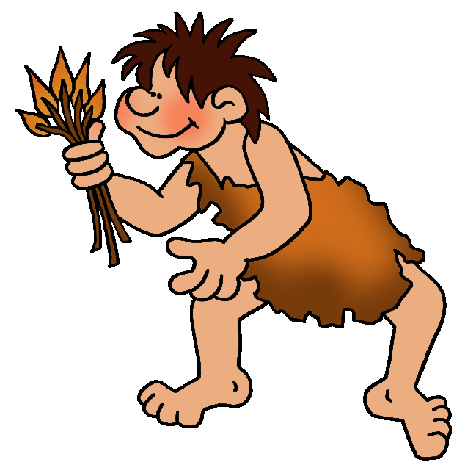
Handy Man
These early human-like hominids were taller and smarter than Lucy’s people, but they did not know how to make fire.
When they broke camp, they probably tried to bring fire with them by carrying lit branches to use to start a new campfire.
If their branches went out, they did without fire until they found something burning.
Built shelters which protected against animal attacks.

Slide 8
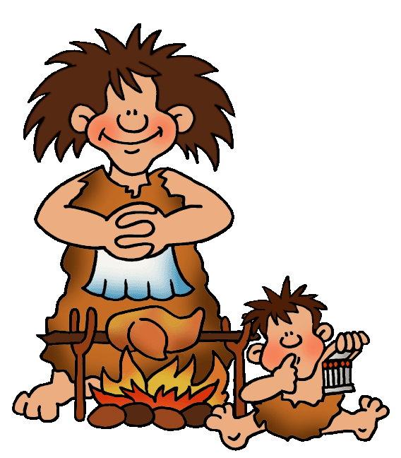
Upright Man
Many years passed. Another group of man was born. Scientists nicknamed this group “Upright Man”. Upright Man did know how to make fire.
That changed everything!
People began to cook their food, which helped to reduce disease. People collected around the fire each night, to share stories of the day's hunt and activities, which helped to develop a spirit of community.

Slide 9
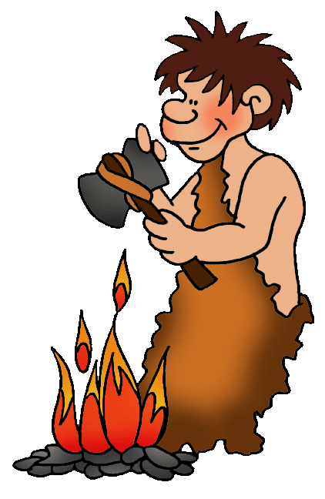
Upright Man
These Stone Age people were about the same size as modern humans. Their tool-making skills were considerably improved. Their weapons included stone axes and knives.
Because Upright Man could make fire, he was free to move about in search of food. He did not have to worry about freezing. He made warm clothes from animal skins. At night, he built a campfire to cook his food and to stay warm.

Slide 10
Man Leaves Home
About one million years ago, Upright Man began to slowly leave Africa. These early people began to populate the world.
They did not need a boat. The Ice Age was here! They traveled across giant walkways of frozen ice or over land bridges.
Scientists have found artifacts of their tools and weapons, which help us to understand how they lived, where they went, and how they got there.

Slide 11
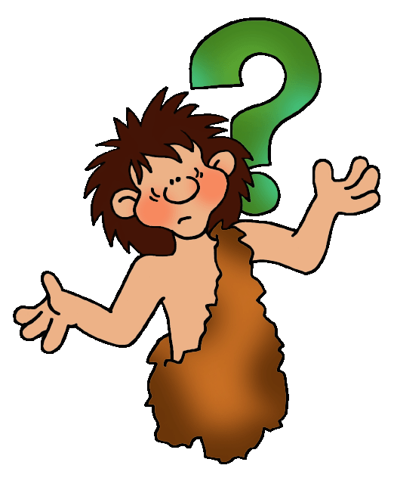
Neanderthals
Neanderthals were different from other species of early humans. They were tall and smart, and used caves as their homes. They were great hunters.
Skilled toolmakers (knives, scrapers and steel points), travelled and hunted in groups, buried their dead with flowers and tools, helped each other when injured, lived in community

Slide 12
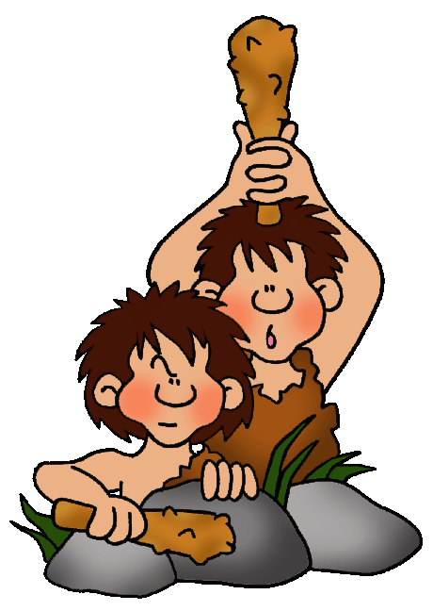
Doubly Wise Man
Another group of early men stood out during this period. Scientists nicknamed this group “Cro-Magnon man”.
Cro-Magnon man lived in Europe.
This group did not live a life of constant struggle for survival because they worked together to provide food for their tribe.

Slide 13
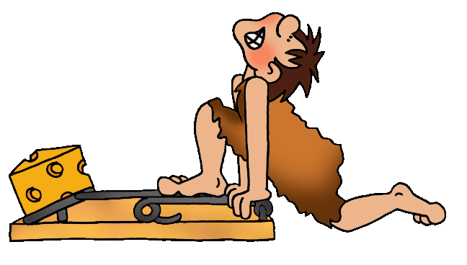
Doubly Wise Man
These Stone Age people learned to cure and store food for the long winter. They used traps, which allowed them to catch food while they were busy doing something else. Fisherman used nets woven from vines and fishhooks.
Some groups built rafts and canoes to catch bigger fish in deeper waters.
They made clothing, jewelry and artwork. They invented the bow and arrow.

Slide 14
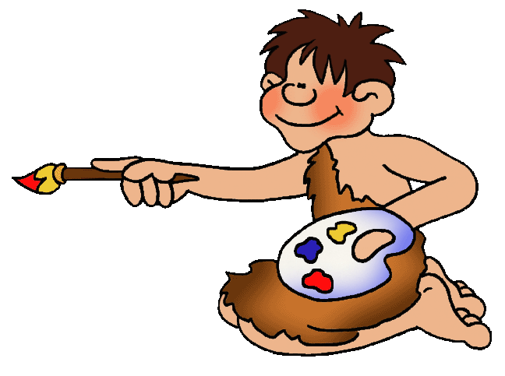
Cave Paintings
Cro-Magnon man did something rather unusual. For some reason, he drew paintings deep inside dark caves, on cave walls.
His paintings were added to the paintings already on the cave walls, left by other Cro-Magnon men.
Over time, a cave might accumulate hundreds of paintings. Colors used most often were brown, yellow/tan, dark red, and coal black.

